Slide 1
Office 365 development
Speaker name

Slide 2
Advanced Office Add-ins with Excel, Word and PowerPoint
</>

Slide 3
Agenda
Office add-ins revisited
Generic Office.js APIs
Word APIs Excel APIs
Deployment

Slide 4
Developer vision

Slide 5
1
Overview

Slide 6
What is an Office add-in?
Web application loaded inside an Office application
Embedded inline or as task pane within documents, mails or appointments
Works in Office applications such as Microsoft Outlook
Works in Office Web Applications such as OWA
Works in mobile Office clients
Office application extensions using web technologies
HTML 5 and CSS used to construct user interface
JavaScript and jQuery used to add executable logic and event handlers
Add-in can provided code to read/write content to/from Office documents
Add-in can call web services hosted over internet or running within local network
Notes:
An Office Add-in can be seen as a Web page loaded inside an Office Application. In some cases it will appear embedded inline within the document. In other cases it might appear as a task pane or within a message in Outlook. Note that the architecture for Office Add-ins has been designed to work in both Office Applications and Office Web Applications.
Office Add-ins allow Office applications to be extended in such as way so that they can leverage Web technologies such as HTML 5 and CSS for rendering user interface as well as JavaScript and jQuery to add behavior. When you write the JavaScript code for an Office Add-in, you can call REST APIs such as those added to SharePoint 2013 to retrieve and update data from across network.

Slide 7
Office add-ins
A new way to build extensions for Office
Contextual mail add-in
Add-in launched contextually from a mail message or appointment
Outlook and Outlook Web Access (OWA)
Task pane add-in
Add-in that runs beside a document/mail with read/write access
Word, Excel, PowerPoint, Project, Outlook
Content add-in
Add-in that runs within a document content with read/write access
Excel, PowerPoint, Access
Add-in command
Command in the Office UI to launch add-in or perform UI-less operation
Outlook and Outlook Web Access (OWA)

Slide 8

Anatomy of an Office add-in
Each Office add-in is based on XML-based manifest
Manifest points to a web page
Manifest defines the type of the Office add-in
Manifest defines which Office applications it supports
Manifest defines required capabilities
Office add-in
Office add-in manifest
<XML>
Web page
HTML+JS
Notes:
Every App for Office must be distributed with an XML-based manifest which contains information about the app itself. For example, the app manifest contains an address to a Web page on the Internet which is used to load the app. The app manifest also includes information which indicates which Office applications it supports. The app manifest also defines the required capabilities which represent the set of permissions that the app needs in order to run and complete its work.

Slide 9
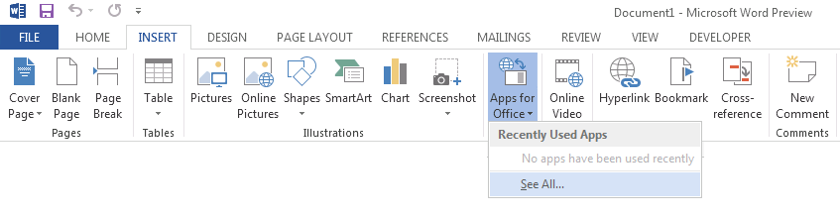
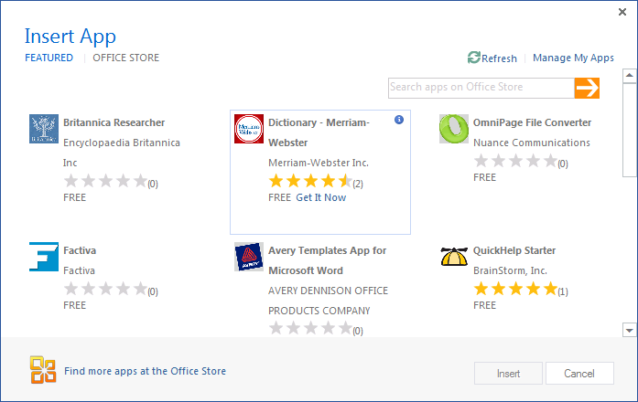
Adding an Office add-in using the insertion UI
Office add-in insertion UI located in Ribbon inside Insert Tab
Dialog allows you to add and start Office add-in
Notes:
Office 2013 applications provide users with the ability to discover add-ins and insert them. In Word and Excel, this support is included in the Ribbon inside the Insert Tab.
When you drop down the Apps menu from the ribbon, you can see recently selected add-ins. If you click "Select All", you will be prompted with a dialog that allows you to look in various app directories. Once you find an add-in you want to use, you can click the Start button to insert the app into the current document and start it up. After this, you can save the current document which will then include the add-in.

Slide 10
2
Generic Office.js APIs

Slide 11
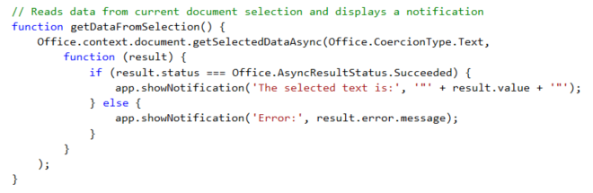
getSelectedDataAsync()
Use this function to read from document select
Notes:
The function getSelectedDataAsync() is used to read content from the selected region of the current Word document.

Slide 12
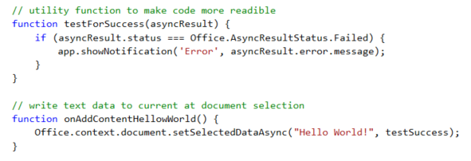
setSelectedDataAsync()
Use this function to insert content into document
Notes:
The function setSelectedDataAsync is used to write content into the selected region of the current document. If there is no selected region, the content is added at the location of the cursor.

Slide 13
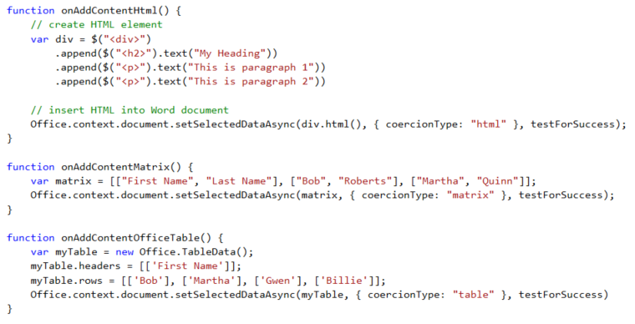
Coercion types
Coercion types make it possible to read/write content in different formats
text - string value
html - HTML content
matrix - array of arrays
table - table of rows and columns
ooxml - Office Open XML format

Slide 14
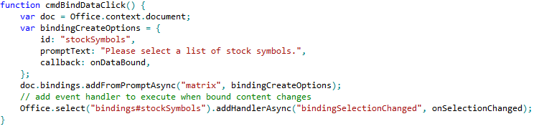
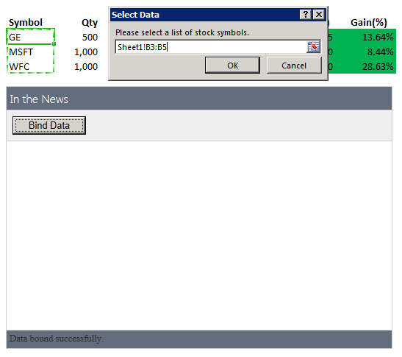
Using bindings
Adding a binding
Bindings.addFromPromptAsync
Bindings.addFromSelectionAsync
Bindings.addFromNamedItem
Referencing a binding
Bindings.getAllAsync
Bindings.getByIdAsync
Office.Select
Removing a binding
Bindings.releaseByIdAsync
Binding event handler to a binding
Binding.addHandlerAsync(“type”, handler);
A dialog is presented to the user experience when you call addFromPromptAsync.
Notes:
To add a binding, you should use one of the following method
Bindings.addFromPromptAsync
Bindings.addFromSelectionAsync
Bindings.addFromNamedItem
You will also need to reference bindings to read and write content and register event handlers. When you need to reference a binding, you can use one of these method.
Bindings.getAllAsync
Bindings.getByIdAsync
Office.Select
If you ever need to remove a binding, you can use this methods.
Bindings.releaseByIdAsync
To register an event handler on a binding, you can use the following method.
Binding.addHandlerAsync(“type”, handler);

Slide 15
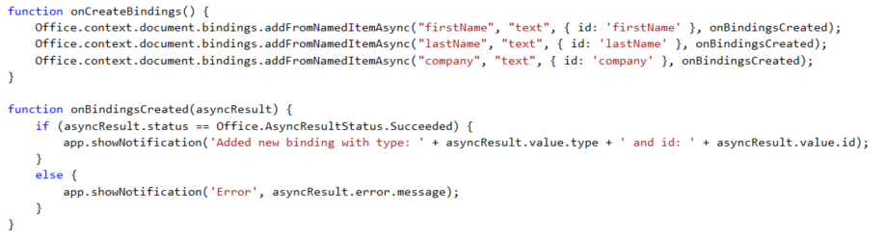

Adding bindings in JavaScript
Notes:
The top code listing shows how to create bindings in JavaScript code using addFromNamedItemAsync. Note that the first parameter (e.g. "firstName") is used to indicate which content control you want to bind to. The third argument (e.g. { id: 'firstName' } is used to create the binding ID that will be used to retrieve the binding when call the Office.select function.
Note that the call to Office.select gets the binding using a syntax of "bindings#" followed by the ID of a registered binding.

Slide 16
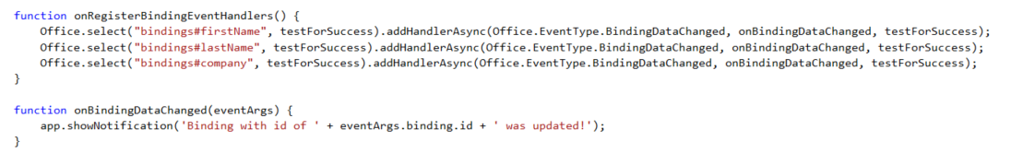
Adding event hander bindings
Event handlers added using addHandlerAsync
Callback function called automatically when user updates binding content
Notes:
This code shows how to register an event handler on a binding using the addHandlerAsync function.
The call also registers a callback function named onBindingDataChanged which is called automatically when user updates the bound content.

Slide 17
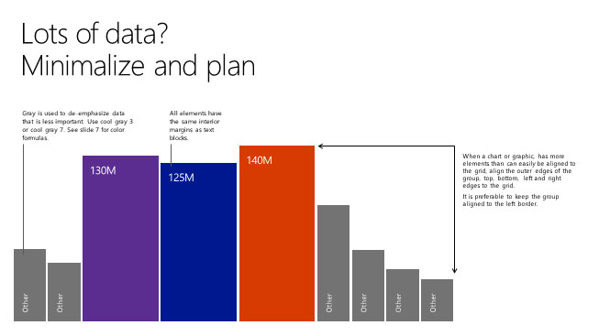
Building your first Office add-in

Slide 18
3
Word/Excel Office.js APIs

Slide 19
New Office 2016 APIs
Batching
Multiple API execution requests can be queued (batched) and executed at once
Promises Syntax
Helps manage complex and nested callback flows in a simple manner
Object oriented design
Enables a friendlier syntax for interacting with complex object hierarchies/graphs
Selective loading
Allows for efficient execution (only necessary properties/objects are marshalled)
Service-compatible
Allows for REST API equivalents with shared interface contracts

Slide 20
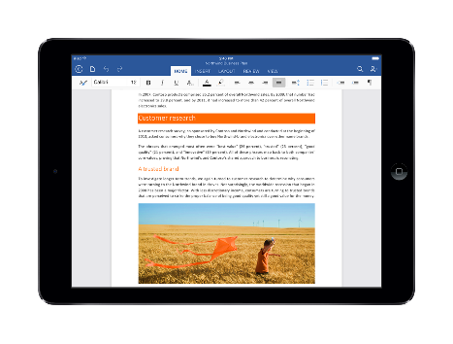
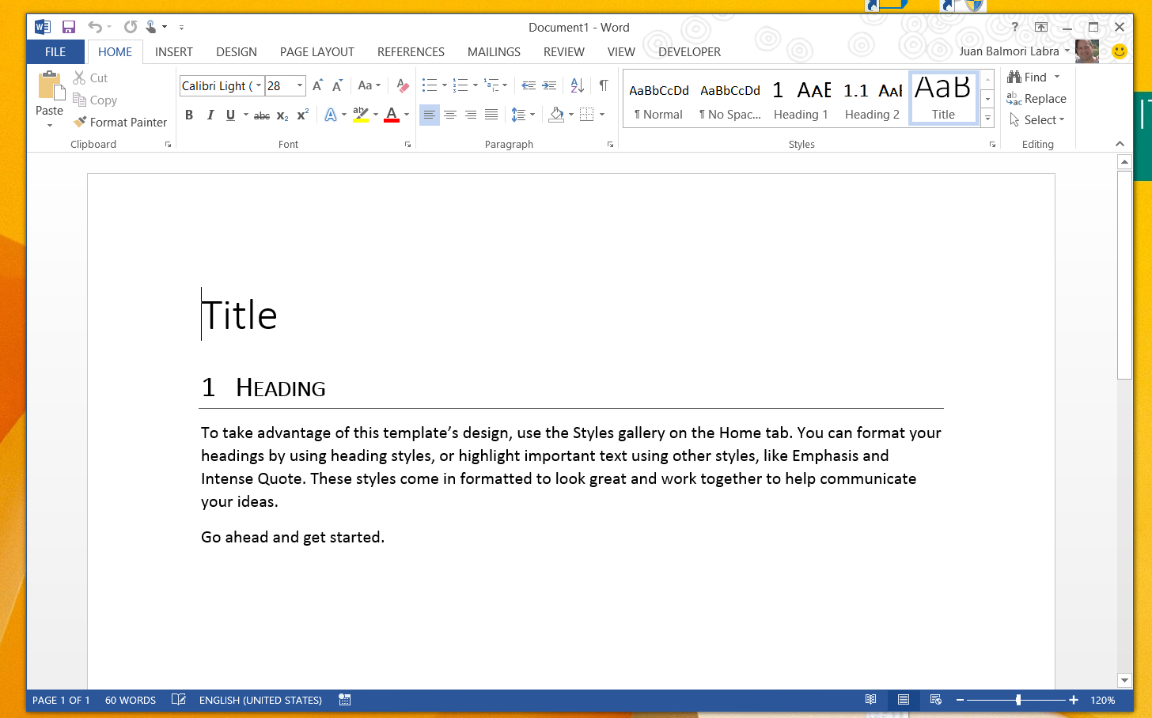
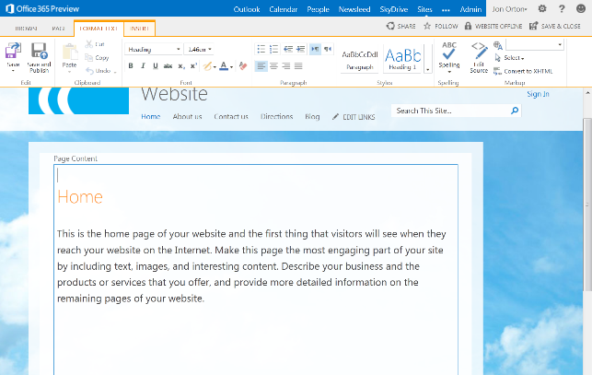
Coding pattern
1: Context initialized
iOS
Excel.run(function (ctx) { });
Desktop
Web

Slide 21
Coding pattern
2: Instructions batched
iOS
Excel.run(function (ctx) {
// Create a proxy object for the active worksheet
var sheet = ctx.workbook.worksheets.getActiveWorksheet();
sheet.getRange("A1").values = "Quarterly Sales Report";
sheet.getRange("A1").format.font.name = "Century";
sheet.getRange("A1").format.font.size = 26;
var range = sheet.getRange("A2:E8");
range.values = values;
sheet.getRange("A2:E2").format.font.bold = true;
});
Desktop
Web

Slide 22
Coding pattern
iOS
Excel.run(function (ctx) {
// Create a proxy object for the active worksheet
var sheet = ctx.workbook.worksheets.getActiveWorksheet();
sheet.getRange("A1").values = "Quarterly Sales Report";
sheet.getRange("A1").format.font.name = "Century";
sheet.getRange("A1").format.font.size = 26;
var range = sheet.getRange("A2:E8");
range.values = values;
sheet.getRange("A2:E2").format.font.bold = true;
return ctx.sync();
});
Desktop
3: Instructions sent to host
Web

Slide 23
Coding pattern
iOS
Excel.run(function (ctx) {
// Create a proxy object for the active worksheet
var sheet = ctx.workbook.worksheets.getActiveWorksheet();
sheet.getRange("A1").values = "Quarterly Sales Report";
sheet.getRange("A1").format.font.name = "Century";
sheet.getRange("A1").format.font.size = 26;
var range = sheet.getRange("A2:E8");
range.values = values;
sheet.getRange("A2:E2").format.font.bold = true;
return ctx.sync();
});
Desktop
4: Host executes instructions in sequence
Web

Slide 24
Coding pattern
iOS
Excel.run(function (ctx) {
// Create a proxy object for the active worksheet
var sheet = ctx.workbook.worksheets.getActiveWorksheet();
sheet.getRange("A1").values = "Quarterly Sales Report";
sheet.getRange("A1").format.font.name = "Century";
sheet.getRange("A1").format.font.size = 26;
var range = sheet.getRange("A2:E8");
range.values = values;
sheet.getRange("A2:E2").format.font.bold = true;
return ctx.sync();
})
.then(function () {
app.showNotification("Success");
console.log("Success!");
});
Desktop
5: Callback handles success
Web

Slide 25
Coding pattern
iOS
Excel.run(function (ctx) {
// Create a proxy object for the active worksheet
var sheet = ctx.workbook.worksheets.getActiveWorksheet();
sheet.getRange("A1").values = "Quarterly Sales Report";
sheet.getRange("A1").format.font.name = "Century";
sheet.getRange("A1").format.font.size = 26;
var range = sheet.getRange("A2:E8");
range.values = values;
sheet.getRange("A2:E2").format.font.bold = true;
return ctx.sync();
})
.then(function () {
app.showNotification("Success");
console.log("Success!");
})
.catch(function (error) {
app.showNotification("Error: " + error);
console.log("Error: " + error);
if (error instanceof OfficeExtension.Error) {
console.log("Debug info: " + error.debugInfo);
}
});
Desktop
6: If exception, catch callback is called
Web

Slide 26
New Word APIs
CRUD and navigation of a Word doc’s core elements
Rich text and paragraph formatting
External data binding through content controls
Rich search and selection
Insert pictures and other documents
Document
Selection
Section
Body
Header
Range
Footer
Paragraph
Font
Picture
Content control

Slide 27
Demo: New Word 2016 APIs
Notes:
Download the following manifest and run to show the sandbox for the new Word APIs: http://1drv.ms/1OiykkN

Slide 28
New Excel APIs
CRUD and navigation of a workbook’s core elements
Rich formatting and content/formula editing for cells, ranges and tables
Data visualization through native charts
Basic manipulation of external data bindings
Workbook
Worksheets
Names
Tables
Range
Charts
Rows
Columns
Legend
Format
Axis
Font
Title
Fill
Series
Borders

Slide 29
Demo: New Excel 2016 APIs
Notes:
Download the following manifest and run to show the sandbox for the new Word APIs: http://1drv.ms/1OiykkN

Slide 30
4
Packaging and deployment

Slide 31
Office add-in deployment
Steps
Deploy the remote web to Windows Azure or to other web server
Build app package which must include HTTPS URL of remote web
Upload app package to app catalog
Choosing an add-in catalog
SharePoint add-in catalog is preferred because it offers several advantages
File share add-in catalog deployment is a simpler, less-powerful option
Notes:
When it is time to deploy an add-in, the actual deployment is similar to standard web site because you must make the Web page for an app and the office supporting files available on a Web server. However, you must also publish the manifest to make the app discoverable for installation. IT admins can designate trusted App Catalogs via Global Policy Objects (GPO). Note that the manifests for Mail Add-ins must be uploaded to Exchange 2013 App Catalog.

Slide 32
SharePoint add-in catalog
Designed for private corporate networks
Provides users with catalog of pre-screened and pre-approved apps
Often used to deploy apps developed in-house of by third party ISV
Supports document-based apps (i.e. Task pane apps and content apps)
SharePoint add-in catalog hosted using site collection
Actual catalog is document library containing app manifests
Administrator can configure app for Office security settings
Notes:
SharePoint 2013 implements the App Catalog using a site collection created from a special site template. The app Catalog is designed for Office 365 and for private corporate networks in that it is available to only to users who have been granted access. It provides users with catalog of pre-screened and pre-approved apps. An App Catalog can be used to deploy apps developed in-house of by 3rd party ISVs. Note that the App Catalog in SharePoint supports document-based apps (i.e. Task pane apps and Content apps).
As already mentioned, the SharePoint App Catalog hosted using a SharePoint 2013 site collection. The actual catalog is simply a document library to which app manifests are uploaded. The administrator can configure app security settings that controls who can see and install the apps inside.

Slide 33
File share add-in catalog
Provides simplest means to deploy apps for Office
Does not require either SharePoint or Exchange
Apps for Office manifests copied to Windows File Share
Office applications configured to read file share to discover apps for Office
Client machine requires registry entry with file share path
Notes:
A File Share App Catalog provides the easiest way to deploy Apps for Office. It does not require either SharePoint 2013 or Exchange 2013. Instead, app manifest are simply copied to a Windows file share. Of course, the user desktops running Office Applications must be configured configured with the correct file share path to discover Apps for Office which can be done manually by user or centrally using GPO.

Slide 34
Related documentation
MSDN: Create a task pane add-in with Napa Office 365 Development Tools https://msdn.microsoft.com/EN-US/library/office/jj554660.aspx
MSDN: Word add-ins https://msdn.microsoft.com/EN-US/library/office/dn833112.aspx
JavaScript API for Office https://msdn.microsoft.com/en-us/library/fp142185.aspx

Slide 35
Related code samples
Office add-in samples http://dev.office.com/codesamples#?filters=office%20add-ins

Slide 36
Summary
Office add-ins Revisited
Generic Office.js APIs
Word APIs
Excel APIs
Deployment

Slide 37
Further reading…
Getting Started with Office add-ins
Office add-in Code Samples
Office add-in Training videos & hands on labs
Office add-in Snack videos
Office add-in documentation

Slide 38
Developer Program launch
1 YEAR FREE
Email Newsletters
Free Developer Subscription
Free Training
Free Tools
Webinars
http://dev.office.com/devprogram

Slide 39
Engage

Slide 40
Thank you

